Slide 1


DIGITAL PORTFOLIO
NAME:S.ALMAS BEGAM
REGISTER NO:24134130500122002
NMID:asanm41341324213003 /
EA69C259921F436955F46704D17637F2
DEPARTMENT:BCA
COLLEGE: DEEN COLLEGE OF ARTS AND SCIENCE -Nidur
Next Slide

Slide 2
STUDENT'S DIGITAL PORTFOLIO
Next Slide

Slide 3
AGENDA:
Problem statement
Project overview
End users
Tools and techniques
Portfolio design and layout
Features and functionality
Results and screenshot
Conclusion
GitHub link
Next Slide

Slide 4
PROBLEM-STATEMENT:
In today's digital age, individuals especially students often struggle to present their skills, achievements, and career highlights in a structured, accessible, and professional format. Traditional resumes or paper portfolios are limited, static, and often fail to showcase one's full potential, especially when it comes to multi-disciplinary profiles.
There is a need for a digital platform that allows individuals to create a personal brand, highlight both academic and extracurricular achievements, and provide contact options which is easy to contact by recruitefor opportunities in employment, sports, or collaboration,
Next Slide

Slide 5
PROJECT OVERVIEW:
The Online Quiz Application is a web-based platform built with HTML, CSS, and JavaScript. It allows users to take quizzes and receive instant feedback. The project demonstrates basic front-end skills like navigation, form handling, and interactive design
Portfolio contain:(Home,about,skills, project,contact)
Leading Idea:
Display personal skills, achievement and projects
Next Slide

Slide 6
WHO ARE THE END USERS:
Recruiters and Employers:
Why they use it. To assess your technical skills, personal qualities, and achievements before offering a job or internship.
What they look for: Skills section, education, personal introduction, and overall presentation
General Public/Online Visitors:
Anyone curious to know more about my profile.
Can reach out through the contact form for queries or opportunities.
Students-Attempt quizzes, get scores
Admins-Manage quiz content
Visitors (optional) - Preview or demo access
Next Slide

Slide 7
TOOLS AND TECHNIQUES:
HTML (Hyper Text Markup Language):
Used to structure the content of the webpage.
CSS (Cascading Style Sheets):
Used to style the webpage (colors, layout, fonts, spacing, responsive design).
JavaScript (Basic):
Used for:
Fetching and sending data
Navigation between sections
Handling form submission
Showing success messages
Next Slide

Slide 8
PORTFOLIO DESIGN AND LAYOUTS:
Design Principles:
1. Clean and minimalistic: Avoid clutter and focus on showcasing your work.
2. Consistent typography: Use a consistent font scheme throughout your portfolio.
3. Color scheme: Choose a palette that reflects your personal brand.
Layout:
1. Simple navigation: Make it easy for visitors to find what they're looking for.
2. Project showcases: Use images, videos, or live demos to showcase your projects.
3. Project descriptions: Provide context and details about each project.
Next Slide

Slide 9
FEATURES AND FUNCTIONALITY:
Responsive Design:
The portfolio is optimized for various devices and screen sizes.
Project Showcase:
I have a section to display your projects with descriptions.
Skills Section:
I listed your technical skills and proficiencies.
About Me:
A brief bio and introduction to who you are and what you do.
Contact Form:
A way for visitors to get in touch with you.
Next Slide

Slide 10
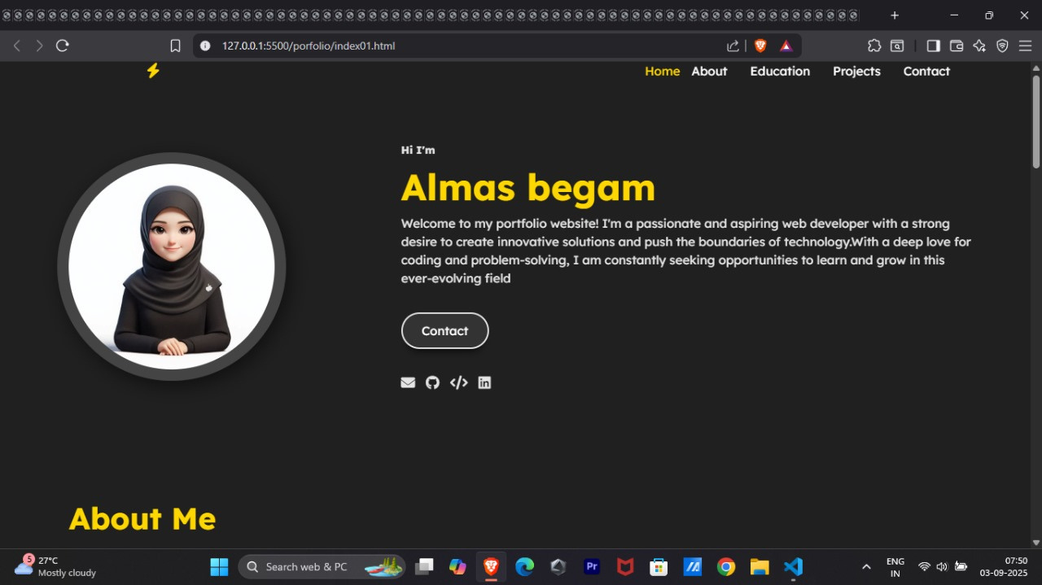
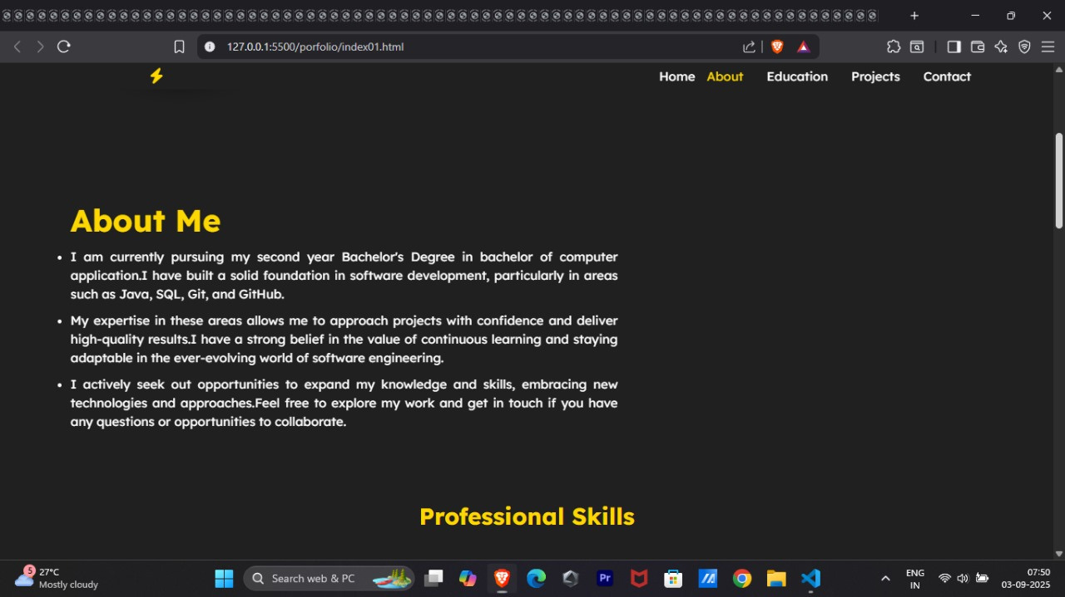
RESULTS AND SCREENSHOTS:
Next Slide

Slide 11
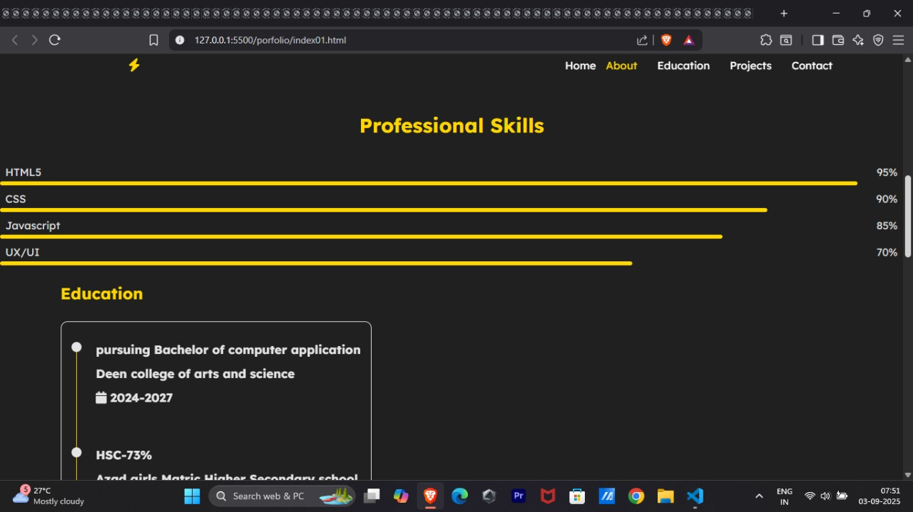
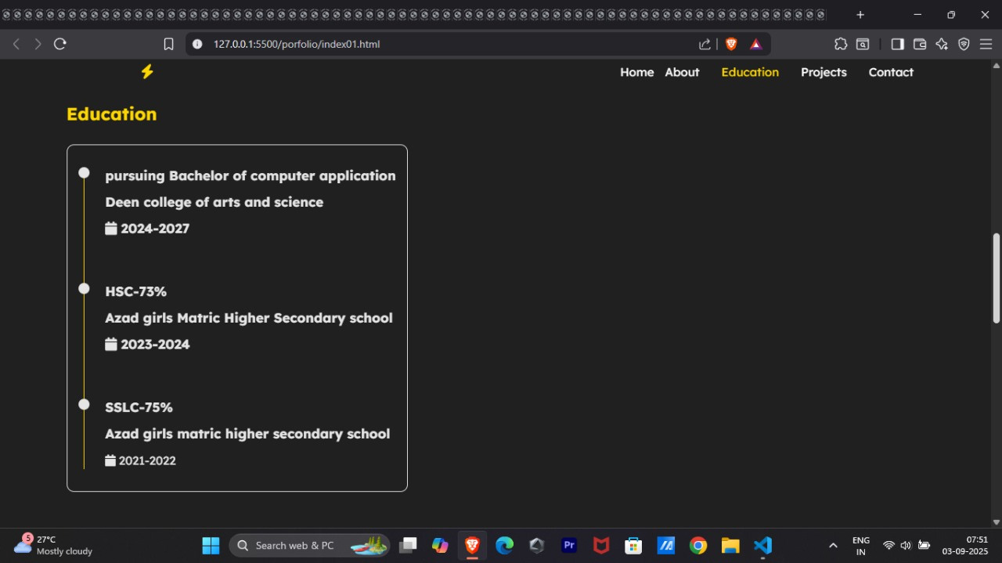
RESULTS AND SCREENSHOTS:
Next Slide

Slide 12
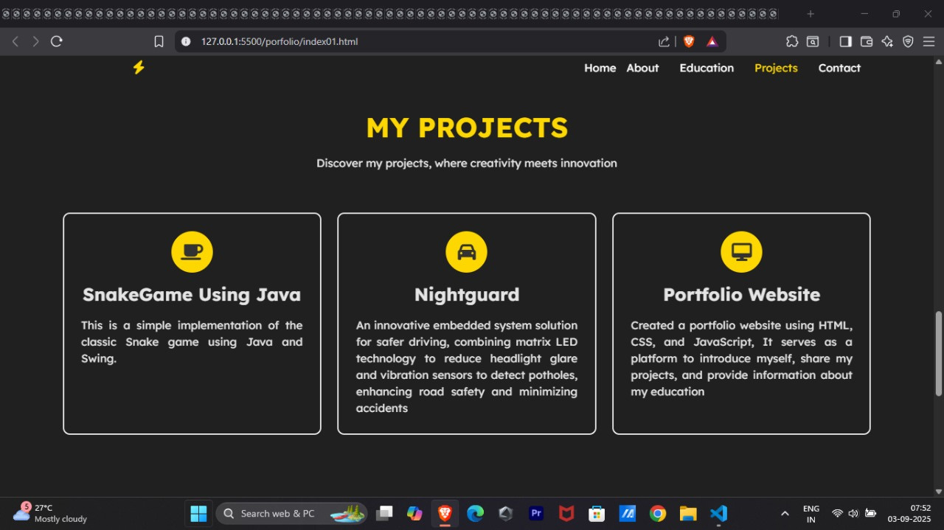
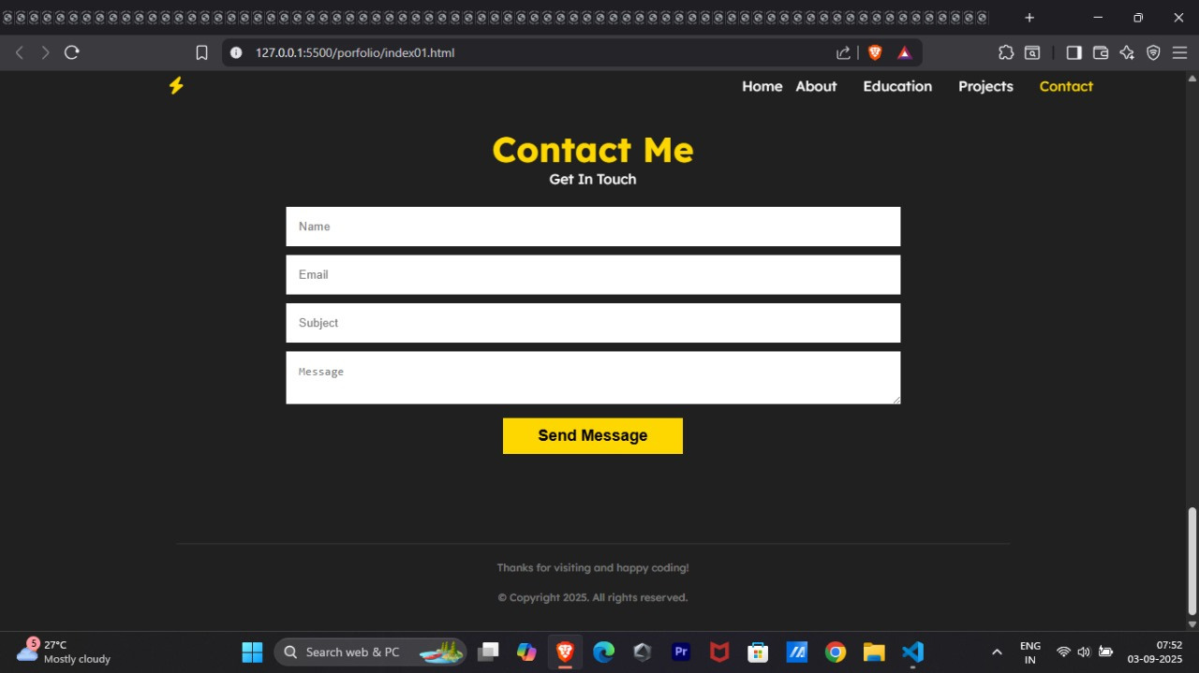
RESULTS AND SCREENSHOTS:
Next Slide

Slide 13
CONCLUSION:
My digital portfolio effectively showcases your skills and experience in web development, with a clean design and functional features. By highlighting your projects, skills, and contact information, you've created a valuable resource for potential employers or collaborators. With some minor enhancements, your portfolio can continue to grow and showcase your expertise in the field.
Next Slide

Slide 14
GITHUB LINK:
https://github.com/Almasbegam/Almas-TNSDC-FWD-DP.git
Next Slide

